Slide 1
Deep learning for image recognition
“Building your very simple neural network architecture for a very simple image recognition”

Slide 2


About me
Seorang mahasiswa aktif
Jurusan T. Elektro FT-Unram
Github : github.com/toufani15
IG : toufani_alfarisi
Email : tofani1515@gmail.com
Machine Learning ID Lombok
t.me/machinelearninglombok

Slide 3
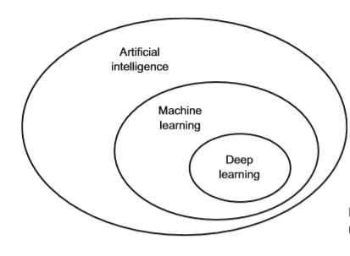
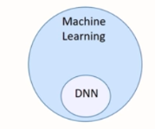
Deep learning apaan ?
Mimic the work of neurons in the brain
Deep learning = Deep neural networks (DNN)
Deep neural netowrks ==> having multiple layers
Source : Sayan Pathak, Principle Engineer ML Scientist - Microsoft

Slide 4
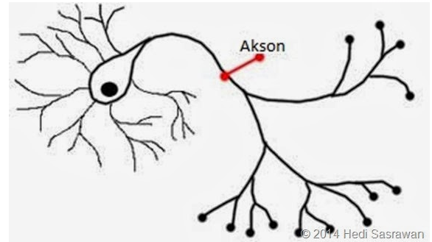
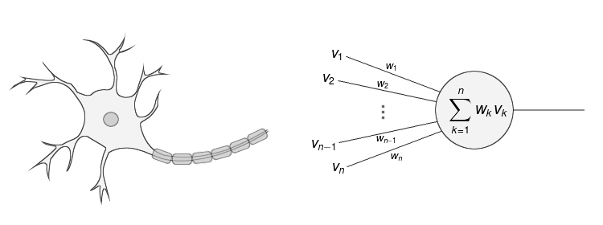
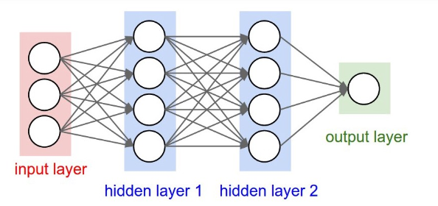
Deep learning apaan ?
Dendrit
Neurit/akson
Badan sel

Slide 5
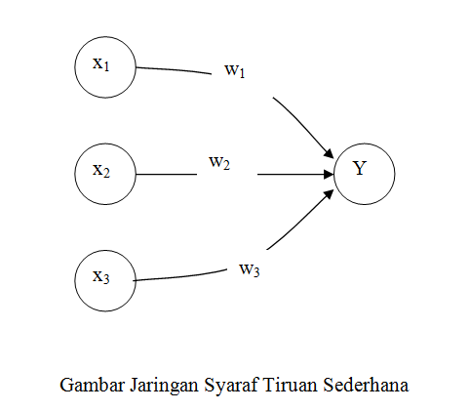
Gimana komputer belajar pake DL ?
Net = X1*W1 + X2*W2 + X3*W3 + b

Slide 6
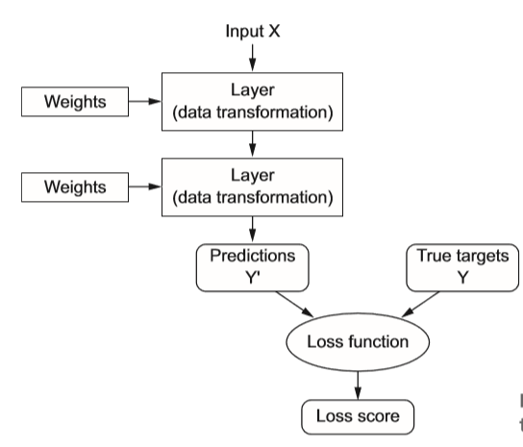
Gimana komputer belajar ?
Input (x) = 3
Output (y) = 9,5
Y = W * 3 + b ⇒ 10,5
x
y
Iterasi 1 : Y = 1 * 3 + 4 ⇒ 7 ➔error = 3,5
Iterasi 2 : Y = 1,5 * 3 + 4 ⇒ 8,5 ➔ error = 2
Iteras 3 : Y = 1.75 * 3 + 4 ⇒ 9,25 ➔ error = 1,25
Iterasi 4 : Y = 2,0 * 3 + 4 ⇒ 10 ➔ error = 0,5

Slide 7
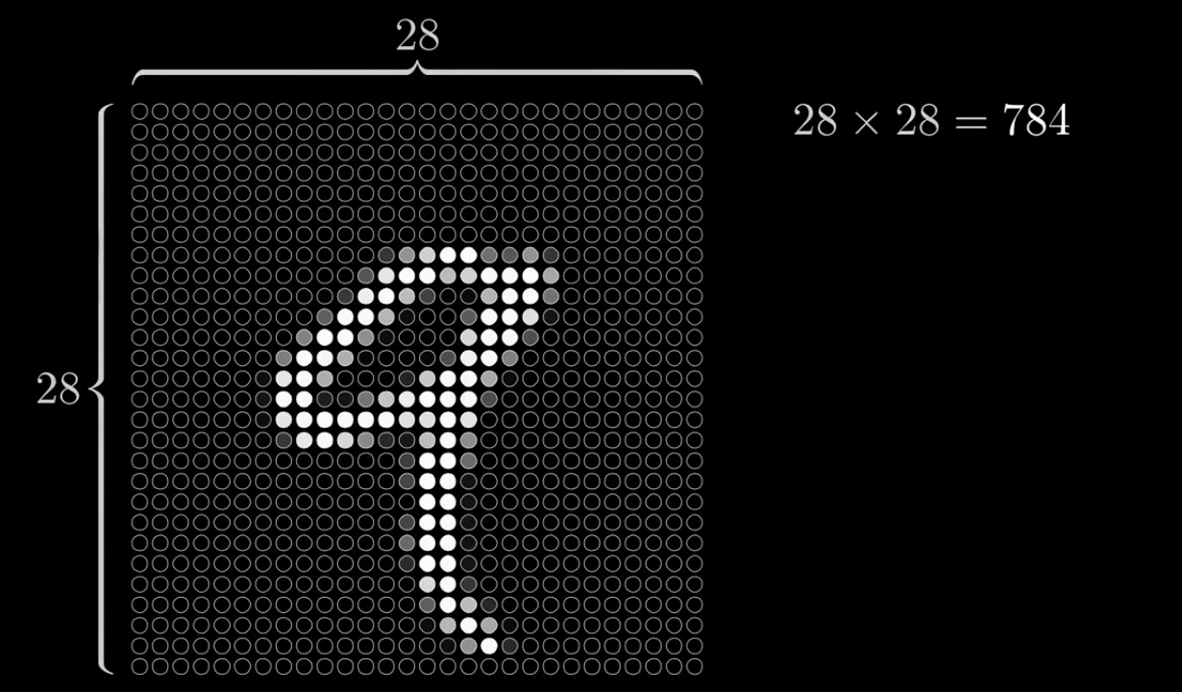

Slide 8
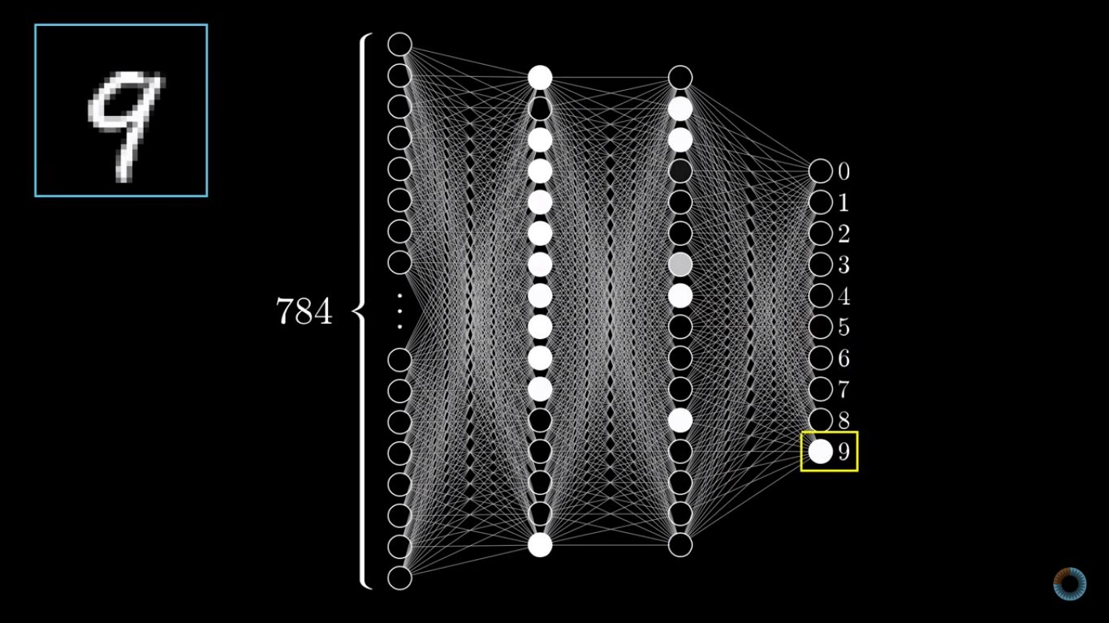

Slide 9
One hot encoding (label binarizer)
Node_out_0 | Node_out_1 | Node_out_2 | Label/output
1 | 0 | 0 | Kucing
0 | 1 | 0 | Dog
0 | 0 | 1 | Panda
0
Kucing
1
Dog
2
Panda

Slide 10
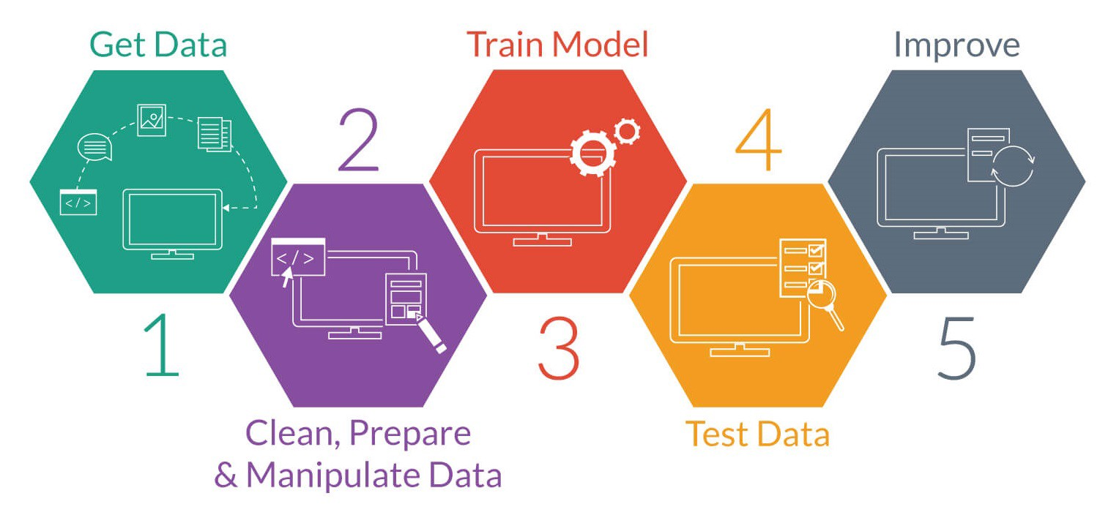
Alur cerita deep learning buat ImReg

Slide 11




Framework DL-ML andelan ?
Labs.cognitiveclass.ai
imutils

Slide 12
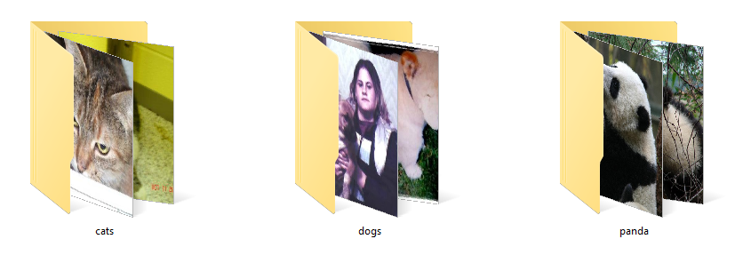
Preprocessing
1000 gambar
1000 gambar
1000 gambar
Resize
Splitting
Encoding

Slide 13
Input layer
Kucing
Dog
Panda
3
3072
1024
512

Slide 14
GO DEMO

Slide 15
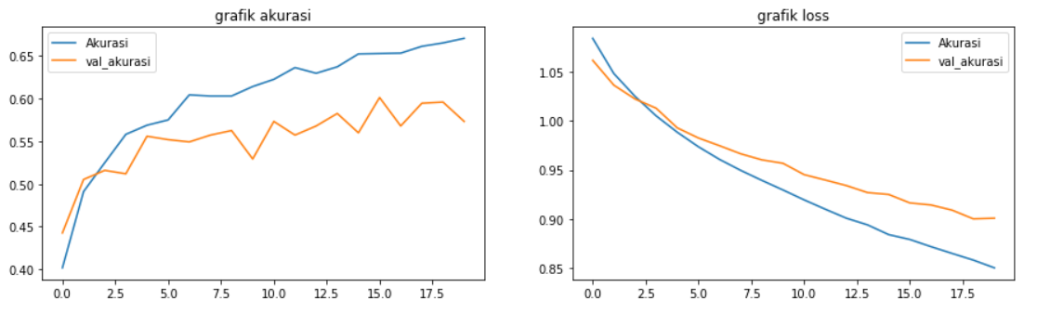
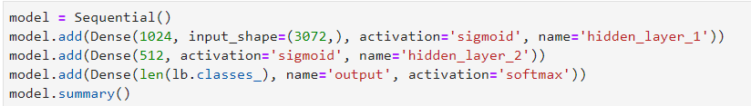
2 hidden layers (32 x 32 px)

Slide 16
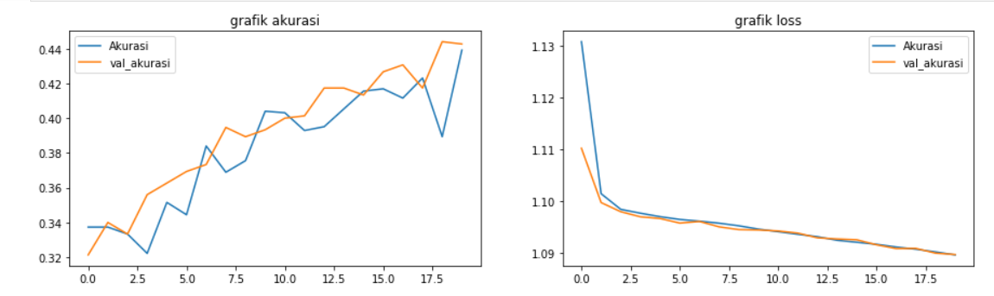
Normalization before training

Slide 17
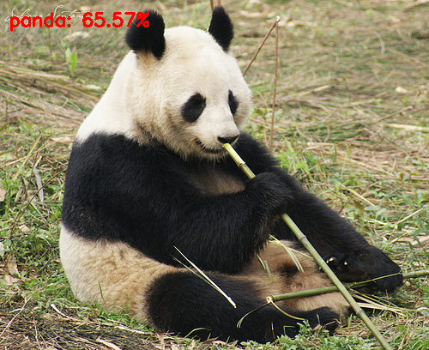
2 Hidden layers dengan resolusi 32x32

Slide 18
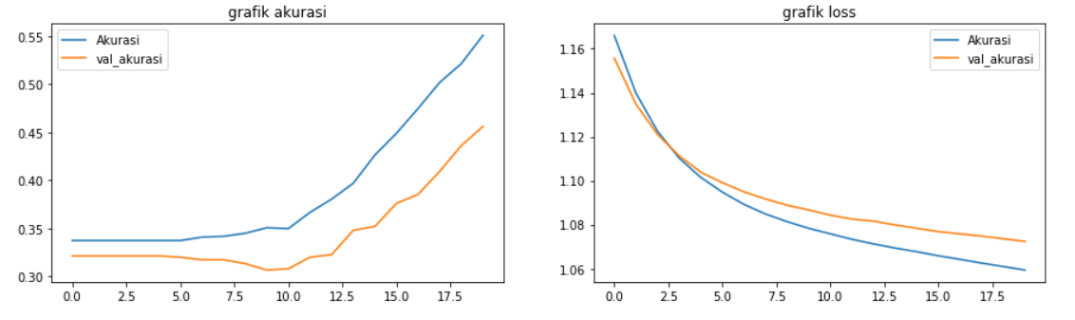
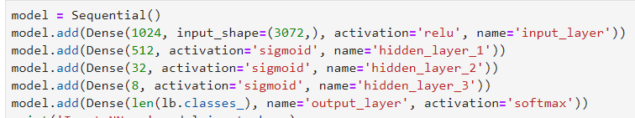
4 hidden layers (32 x 32 px)

Slide 19
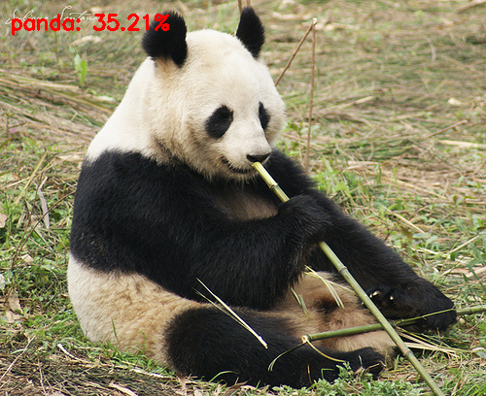
4 Hidden layers (32 x 32 px)

Slide 20
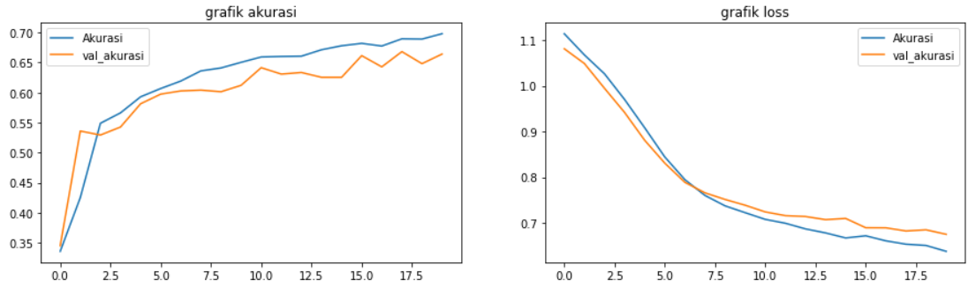
Arsitektur CNN

